Slide 1
The Deep Sea

Slide 2
Inhoud
Eerste sprint
PvE/Werkzaamheden
Technisch ontwerp
Keuzes
Tweede sprint
PvE/Werkzaamheden
Software
Welke
Inrichting

Slide 3
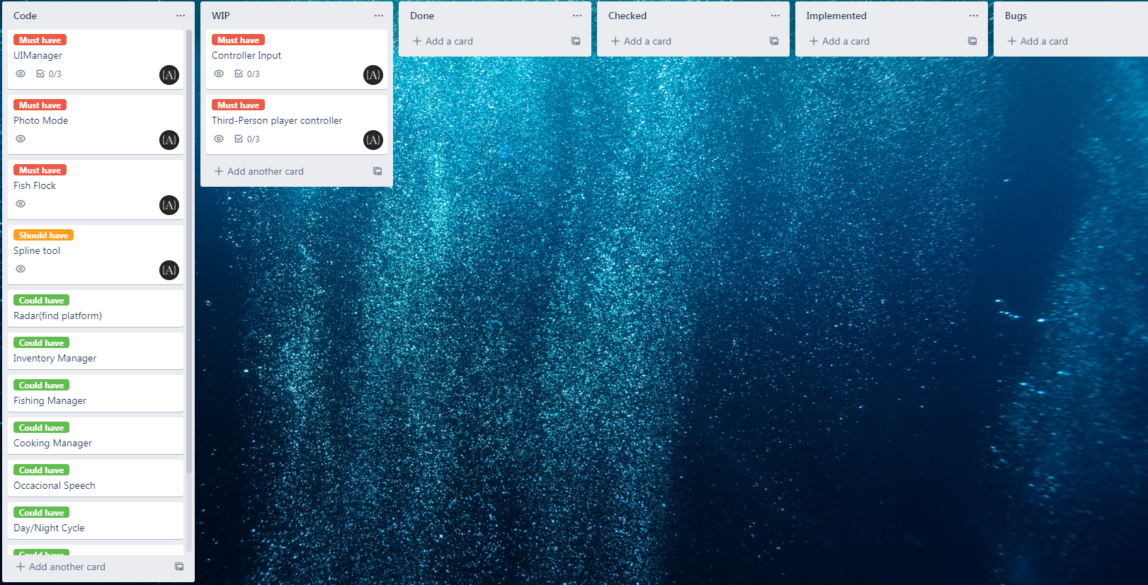
Eerste sprint
PvE
Third-person controller
Controller support
Intuitieve controls
Minimale HUD
 | Week 1 | Week 1 | Week 2 | Week 2
Maandag | Character controller | Character controller | UI (Photo mode) | UI (Photo mode)
Dinsdag | Character controller | Controller support | UI (Photo mode) | UI (Photo mode)
Woensdag | Controller support | Controller support | UI (Photo mode) | UI (Photo mode)
Donderdag | Presentatie K1 W2/3/4 | Presentatie K1 W2/3/4 | OFF DAY | OFF DAY
Vrijdag | OFF DAY | OFF DAY | OFF DAY | OFF DAY
Zaterdag | OFF DAY | OFF DAY | OFF DAY | OFF DAY
Zondag | OFF DAY | OFF DAY | OFF DAY | OFF DAY

Slide 4
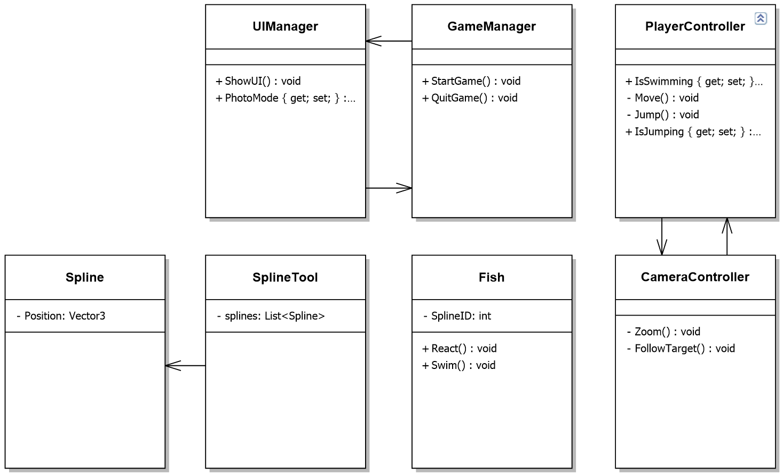
Technisch ontwerp
Keuzes
Minimaal
Overzicht
Performance
Controller type
Uitbreidbaar

Slide 5
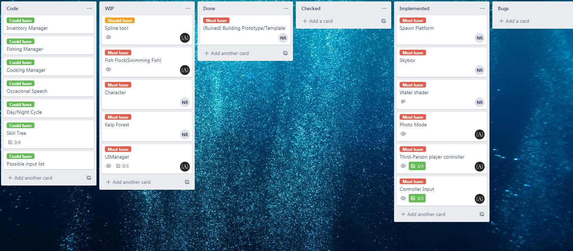
Tweede sprint
PvE
Zwemmende vissen
Vissen reageren op speler
 | Week 1 | Week 1 | Week 2 | Week 2
Maandag | Character controller | Character controller | UI (Photo mode) | UI (Photo mode)
Dinsdag | Character controller | Controller support | UI (Photo mode) | UI (Photo mode)
Woensdag | Controller support | Controller support | UI (Photo mode) | UI (Photo mode)
Donderdag | Presentatie K1 W2/3/4 | Presentatie K1 W2/3/4 | OFF DAY | OFF DAY
Vrijdag | OFF DAY | OFF DAY | OFF DAY | OFF DAY
Zaterdag | OFF DAY | OFF DAY | OFF DAY | OFF DAY
Zondag | OFF DAY | OFF DAY | OFF DAY | OFF DAY
 | Week 3 | Week 3 | Week 4 | Week 4
Maandag | Spline Tool | Spline Tool | Fish Flock | Fish Flock
Dinsdag | Spline Tool | Spline Tool | Fish Flock | Fish Flock
Woensdag | Spline Tool | Spline Tool | Fish Flock | Fish Flock
Donderdag | OFF DAY | OFF DAY | OFF DAY | OFF DAY
Vrijdag | OFF DAY | OFF DAY | OFF DAY | Sprint Review
Zaterdag | OFF DAY | OFF DAY | OFF DAY | OFF DAY
Zondag | OFF DAY | OFF DAY | OFF DAY | OFF DAY

Slide 6
Software
Welke
Github desktop (team)
Visual studio 2019 (programmeren)
Unity (project omgeving)
Unity hub (Unity versie controle)
Misc
Trello (planning)
Google docs (documentatie)
Nclass (UML)
Discord (communicatie)

Slide 7
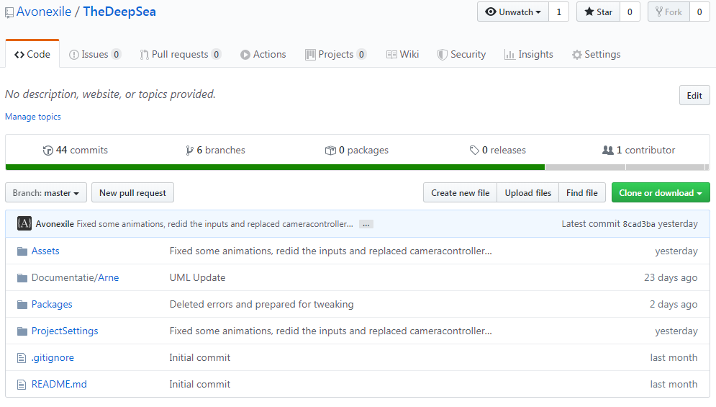
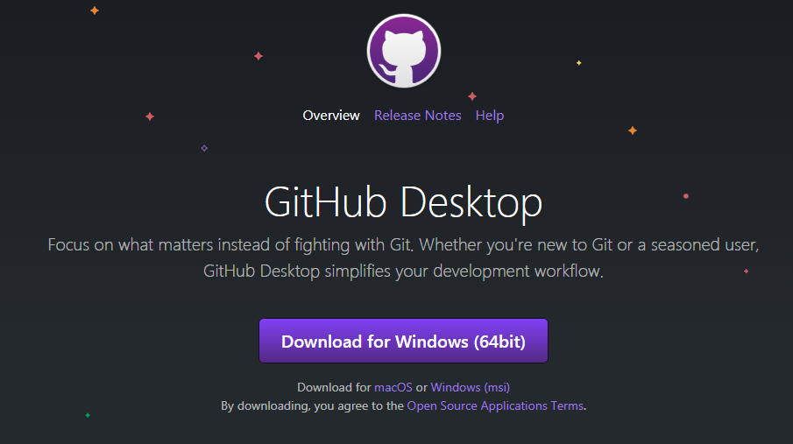
Software
Inrichting
Github repository (github site)
Maak repository
Github desktop
Nieuwste versie
Visual studio 2019
https://visualstudio.microsoft.com/vs/
Unity Hub
https://unity3d.com/get-unity/download
Unity
Via Unity Hub
Versie 2019.2.19f1

